Slide 1
Distributed Systems Week 3 – Multithreaded File Server
Athlone Institute of Technology
2021

Slide 2
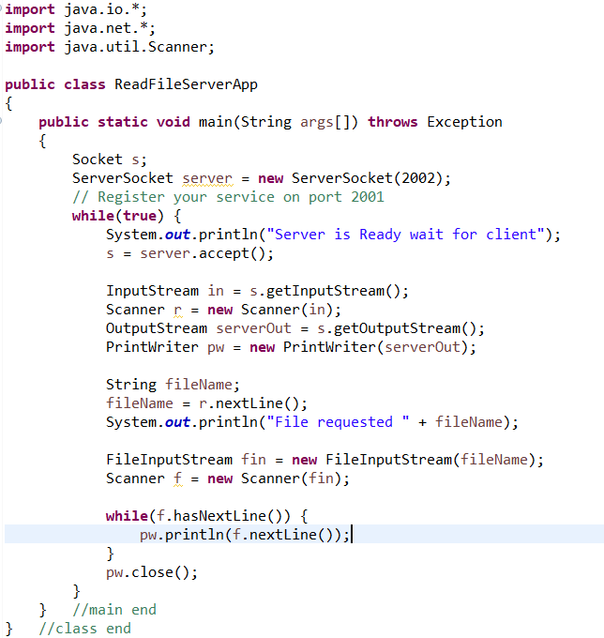
Last Week
Distributed Systems - Week 3: Multithreaded File Server

Slide 3
Server
Accept connection from the Client.
Set up Scanner and PrintWriter.
Read the name of a file.
Get a FileInputStream for a file of this name.
Get a second Scanner for the file (say f).
Distributed Systems - Week 3: Multithreaded File Server

Slide 4
Single Threaded Server
A singly threaded server repeatedly does the above in a single thread.
Will not perform well.
While the server is blocked waiting for I/O (data from disk), no other connections can be accepted.
Distributed Systems - Week 3: Multithreaded File Server

Slide 5
Multi-Threaded Web Server
For every request, a new threaded is created to handle that request.
In most cases performs better than a singly threaded solution.
But it is dangerous to not limit the number of threads in an application.
Distributed Systems - Week 3: Multithreaded File Server

Slide 6
Multi-Threaded Web Server
If too many threads are created, the application can run out of memory.
Also there can be a limit on the number of threads that an Operating System will create.
Threads are continually being created and destroyed.
Distributed Systems - Week 3: Multithreaded File Server

Slide 7
Thread Pool Web Server
The best solution.
A predefined number of threads are created (called the Thread Pool).
Requests are passed to a thread taken from the pool.
The thread is returned to the pool when the request has been processed.
Operating Systems & Concurrency - Week 11

Slide 8
Multi-Threaded File Server
An example of when multi-threaded processes are useful is a file or Web server.
A file/Web server has to block for disk I/O regularly.
If the server is multi-threaded, then when one thread is blocked another thread can execute and handle another request.
Distributed Systems - Week 3: Multithreaded File Server

Slide 9
Multi-Threaded Web Server
Main Thread
Repeat
Accept connection Start handler thread
Handler Thread 1 Handler Thread 2
Read request from client Read file from disk
Send File contents to Client
Read request from client Read file from disk
Send File contents to Client
Distributed Systems - Week 3: Multithreaded File Server

Slide 10
Multi-Threaded Web Server
Accept connection
Thread Factory
Create Threads
Read / Write
Thread A
Worker Threads
Read / Write
Thread B
Read / Write
Thread C
Read / Write
Thread D
Distributed Systems - Week 3: Multithreaded File Server

Slide 11
Multi-Threaded Servers
Rewrite the server, that copied requested files to a client, as a multi threaded server.
The main method should loop, accept connections and create WorkerThreads to handle each connection.
Pass the Socket into the WorkerThread constructor, which should store the reference.
Distributed Systems - Week 3: Multithreaded File Server

Slide 12
Multi-Threaded Servers
The run() method needs to have try .. Catch clause [You can′t declare the run() method to throw Exception]
The run() method should set up the appropriate input and output streams and handle the request from the client.
[Note – Here there is no limit on the number of Threads created. This will be fixed later.]
By using the sleep() method, demonstrate that two threads are running on the server at the same time.
Distributed Systems - Week 3: Multithreaded File Server

Slide 13
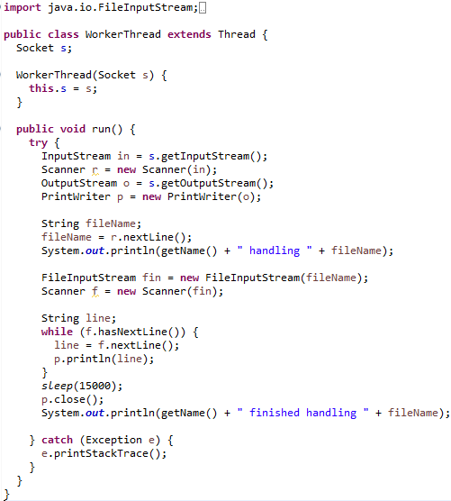
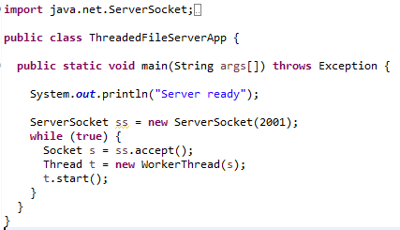
ServerSide Code:
Distributed Systems - Week 3: Multithreaded File Server

Slide 14
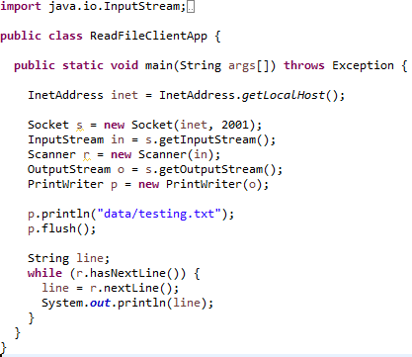
ClientSide Code:
Distributed Systems - Week 3: Multithreaded File Server

Slide 15
Thread Pool Web Server
The previous solution for a Web Server means there is an unlimited number of threads in the server.
With heavy use, the system could crash (out of memory).
Distributed Systems - Week 3: Multithreaded File Server

Slide 16
Thread Pool Web Server
A thread pool creates a number of threads when it starts.
After this initialization, the number of threads doesn’t change.
The main thread puts requests into a queue and the worker threads extract requests from the queue.
Distributed Systems - Week 3: Multithreaded File Server

Slide 17
Thread Pool Web Server - Architecture
BlockingQueue
main thread
accept()
handler threads
read/write
Distributed Systems - Week 3: Multithreaded File Server

Slide 18
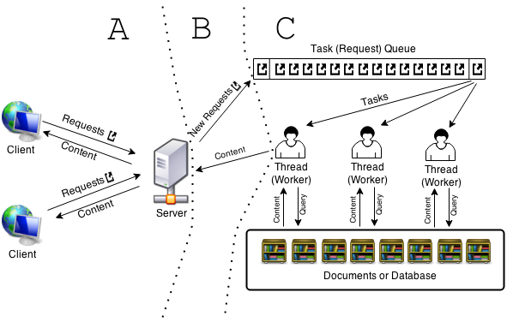
Multi-Threaded Web Server

Slide 19
Multi-Threaded Web Server
Main Thread
Repeat
accept connection
Put connection into queue
Handler Thread 1
Handler Thread 2
Repeat
Read connection from queue Read request from client Read file from disk
Send File contents to Client
Repeat
Read connection from queue Read request from client Read file from disk
Send File contents to Client
Distributed Systems - Week 3: Multithreaded File Server

Slide 20
ArrayBlockingQueue
A bounded blocking queue backed by an array. This queue orders elements FIFO (first-in-first-out). The head of the queue is that element that has been on the queue the longest time. The tail of the queue is that element that has been on the queue the shortest time.
New elements are inserted at the tail of the queue, and the queue retrieval operations obtain elements at the head of the queue.
Distributed Systems - Week 3: Multithreaded File Server

Slide 21
ArrayBlockingQueue
java.util.concurrent.BlockingQueue<T>
Thread Safe
Blocking methods
put(T)
T take()
java.util.concurrent.ArrayBlockingQueue<T>
Distributed Systems - Week 3: Multithreaded File Server

Slide 22
ArrayBlockingQueue (cont’d)
This is a classic "bounded buffer", in which a fixed-sized array holds elements inserted by producers and extracted by consumers. Once created, the capacity cannot be changed.
Attempts to put an element into a full queue will result in the operation blocking; attempts to take an element from an empty queue will similarly block.
Distributed Systems - Week 3: Multithreaded File Server

Slide 23
Example: BlockingQueue
public class BlockingQueueExample {
public static void main(String[] args) throws Exception {
BlockingQueue<String> queue = new ArrayBlockingQueue<String>(1024); Producer producer = new Producer(queue);
Consumer consumer = new Consumer(queue);
new Thread(producer).start(); new Thread(consumer).start();
Thread.sleep(4000);
}
}
Distributed Systems - Week 3: Multithreaded File Server

Slide 24
Example: BlockingQueue - Details
The example uses the ArrayBlockingQueue implementation of the BlockingQueue interface.
First, the BlockingQueueExample class starts a Producer and a Consumer in separate threads.
The Producer inserts strings into a shared BlockingQueue, and the Consumer takes them out.
Distributed Systems - Week 3: Multithreaded File Server

Slide 25
Example: BlockingQueue -Producer
public class Producer implements Runnable{ protected BlockingQueue queue = null; public Producer(BlockingQueue queue) {
this.queue = queue;
}
public void run() { try {
queue.put("1");
Thread.sleep(1000); queue.put("2"); Thread.sleep(1000); queue.put("3");
} catch (InterruptedException e) { e.printStackTrace(); }
}
}
Distributed Systems - Week 3: Multithreaded File Server

Slide 26
Example: Producer - Details
In the Producer class, notice how it sleeps a second between each put() call.
This will cause the Consumer to block, while waiting for objects in the queue.
Distributed Systems - Week 3: Multithreaded File Server

Slide 27
Example: BlockingQueue -Consumer
public class Consumer implements Runnable{ protected BlockingQueue queue = null; public Consumer(BlockingQueue queue) {
this.queue = queue;
}
public void run() {
try {
System.out.println(queue.take()); System.out.println(queue.take()); System.out.println(queue.take());
} catch (InterruptedException e) { e.printStackTrace();
}
}
}
Here is the Consumer class. It just takes out the objects from the queue, and prints them to System.out.
Distributed Systems - Week 3: Multithreaded File Server

Slide 28
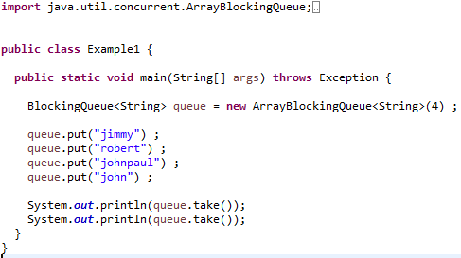
QueueExample.java
Distributed Systems - Week 3: Multithreaded File Server

Slide 29
Server: ArrayBlockingQueue
We will use BlockingQueue<Socket>
Can put Sockets (connections) onto a queue.
And take Sockets from the queue.
Distributed Systems - Week 3: Multithreaded File Server

Slide 30
ReadFileServerApp
Create an ArayBlockingQueue<Socket> (which holds sockets)
Create 4 WorkerThreads in a for loop passing in their name and a reference to the queue.
Start the threads
Loop
accept connection
put it on the queue
Distributed Systems - Week 3: Multithreaded File Server

Slide 31
WorkerThread
Loop
Take a Socket off the queue.
Deal with the Socket (request) as before.
Distributed Systems - Week 3: Multithreaded File Server

Slide 32
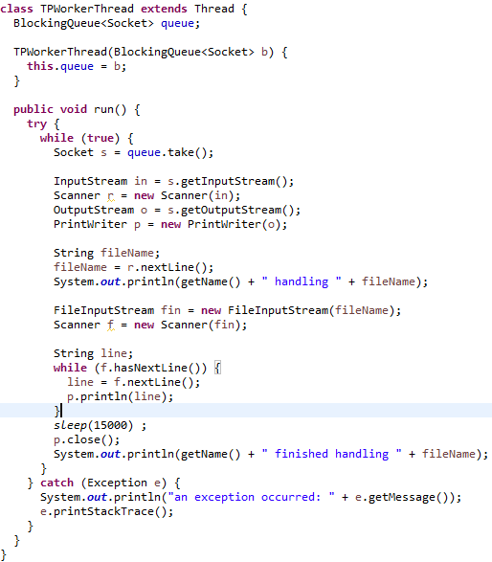
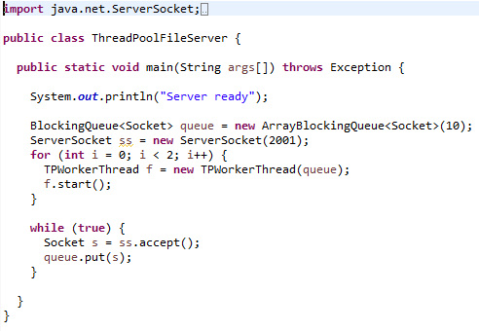
ServerSideCode:
Note: Queue size of 10 allowed, but only handling 2 at a time (for loop <2)
Distributed Systems - Week 3: Multithreaded File Server

Slide 33
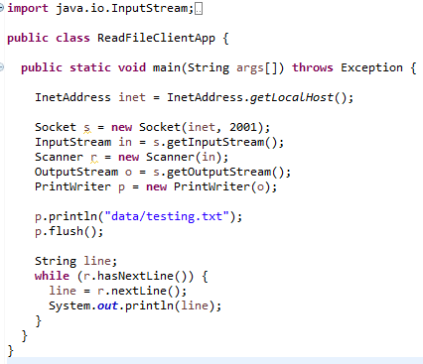
ClientSideCode:
Distributed Systems - Week 3: Multithreaded File Server

